Slide 1



Port City International University Farmer and Digital Marketplace
Supervised by:
Mr. Abdur Rahman
Sr. Lecturer
Department of CSE
Port City International University
Presented by:
Muhammad Arman
ID: CSE-01506379
Batch: CSE-15 (A) DAY
Port City International University

Slide 2
CONTENTS
Introduction
Motivation
Limitation Of Existing System.
Aims & Objective
System Architecture
E-R Diagram
System Requirements
Implementation
Conclusion

Slide 3
Introduction:
The farmer and digital marketplace is an E-Commerce system.
This system will increase the farmer’s sales and reducing the user workload.
Farmers can also get benefited by the weather report provided by our system.

Slide 4
Motivation
Nowadays the price of the vegetables is high and farmer can not sell there products on fair price.
Farmer and entrepreneurship reduce day by day.

Slide 5
Objective:
The main aim of Farmer and digital marketplace is to make a shopping simply space for the Farmer and User.
To increase entrepreneurship and make more profit.
To make easiest way to buy and sell products safe through in like Covid-19 situation.

Slide 6
Limitation of existing system:
Though in present there has not any online system for farmer to buy/deliver products.
Nowadays people go to market to shopping and as a result they have to face a lot of problems and waste time.
There has not any space of shopping products from farmer safely, even farmer cannot sell their products well.

Slide 7
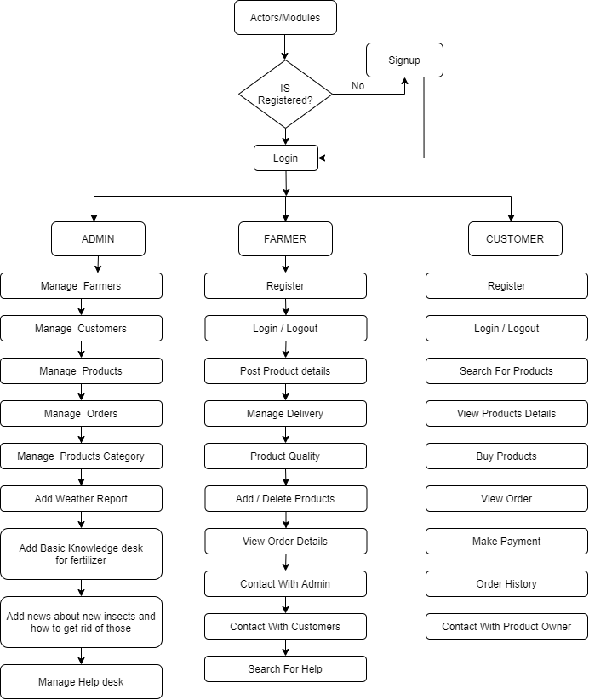
System architecture

Slide 8
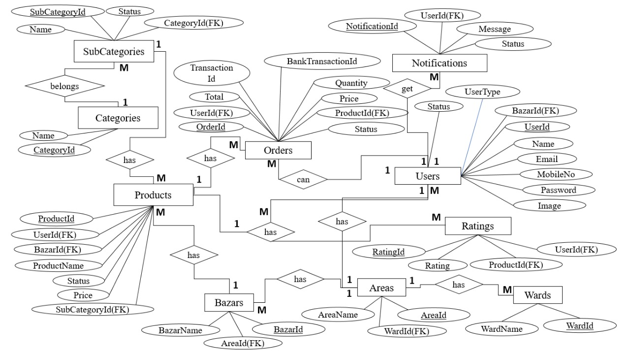
ER-DIAGRAM

Slide 9
System requirements
IDE : Visual studio Cod
Front end : HTML, CSS, JavaScript
Front-end framework : Bootstrap
Back end : PHP, JavaScript
Back end framework : Laravel
Database : MySQL

Slide 10
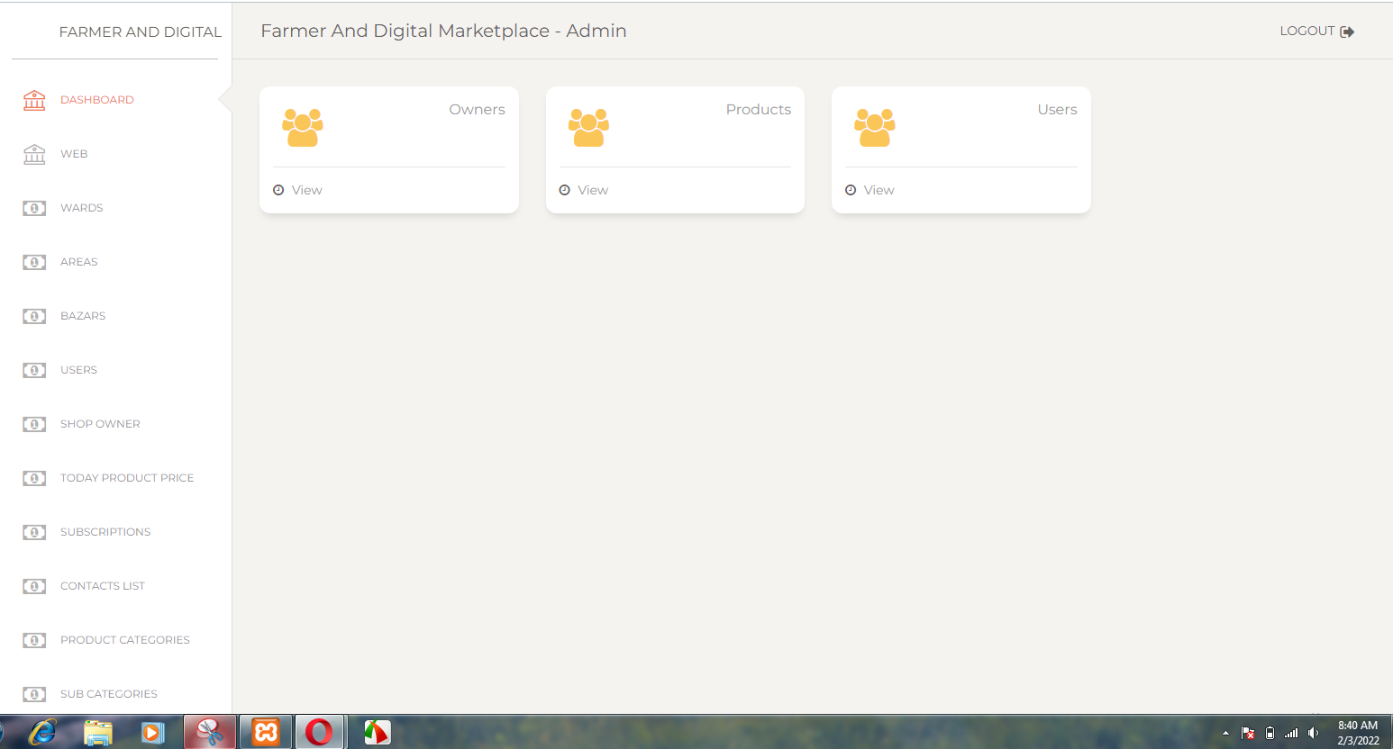
Implementation ( admin)

Slide 11
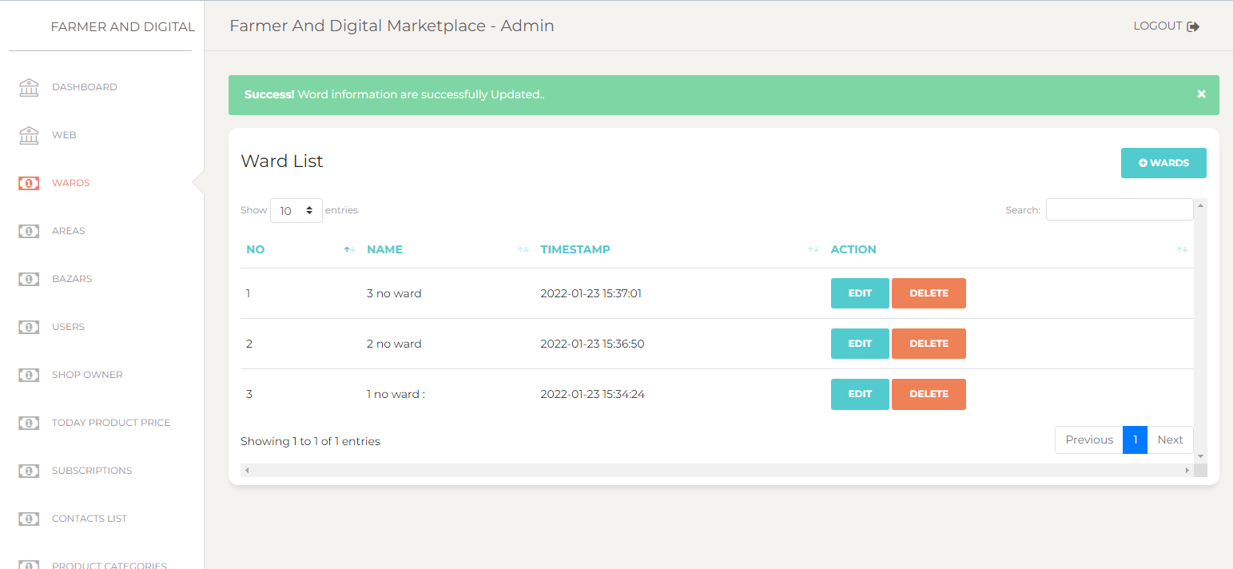
Implementation (admin)

Slide 12
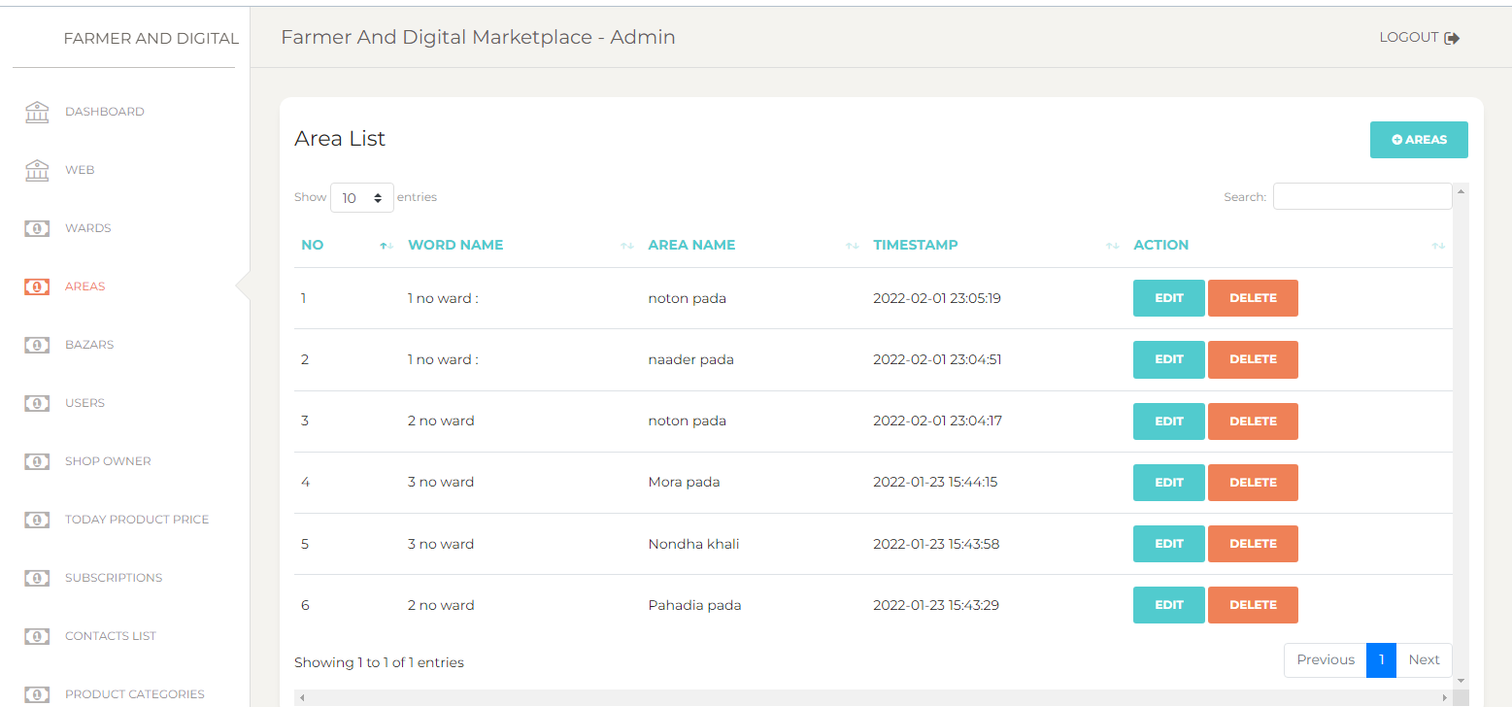
Implementation (admin)

Slide 13
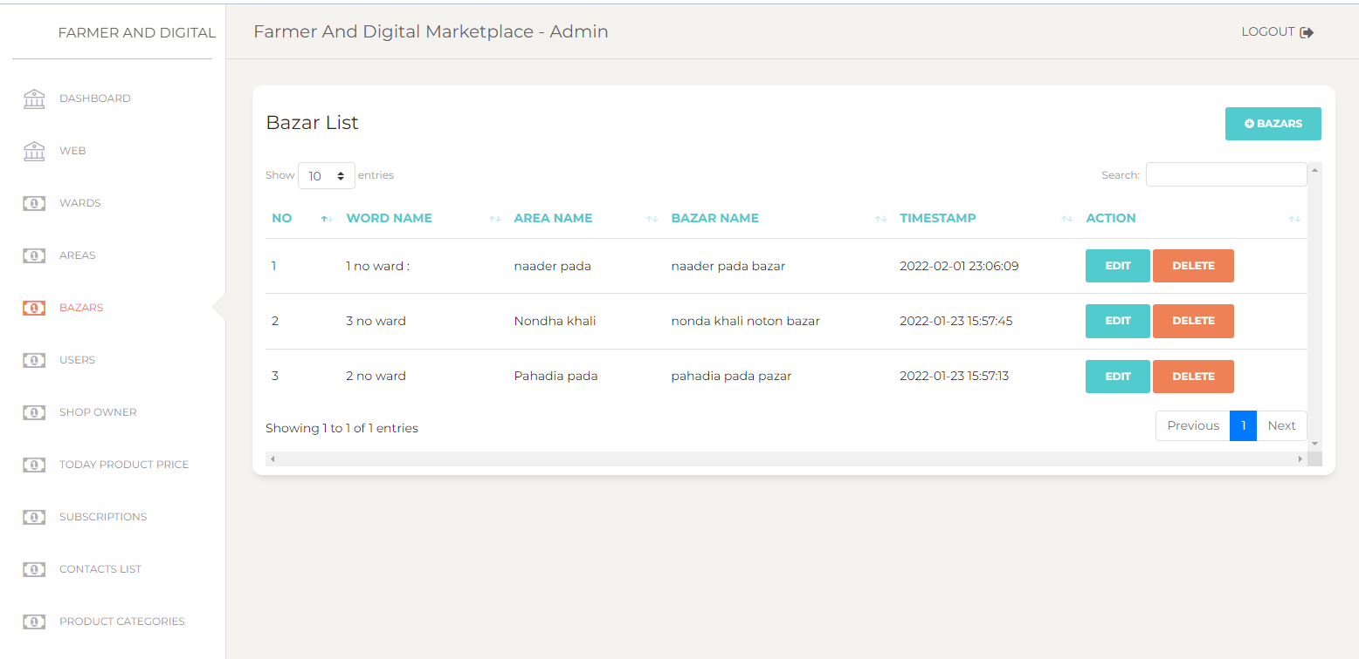
Implementation (admin)

Slide 14
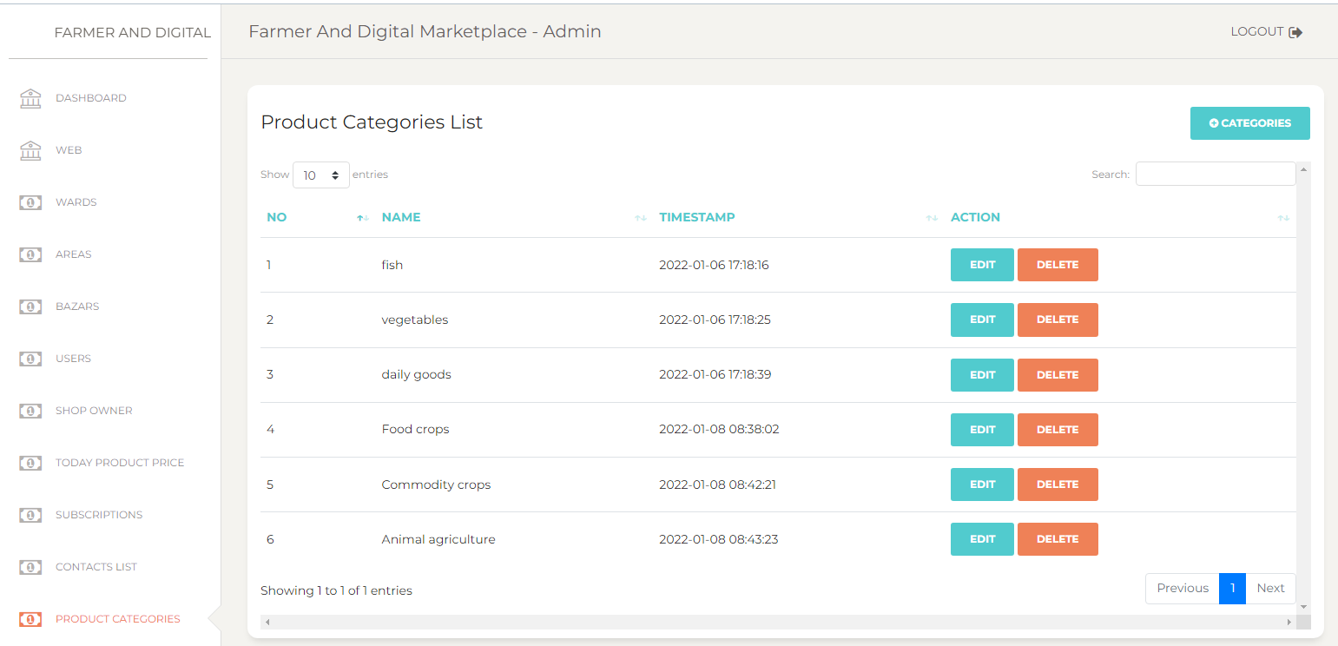
Implementation (admin)

Slide 15
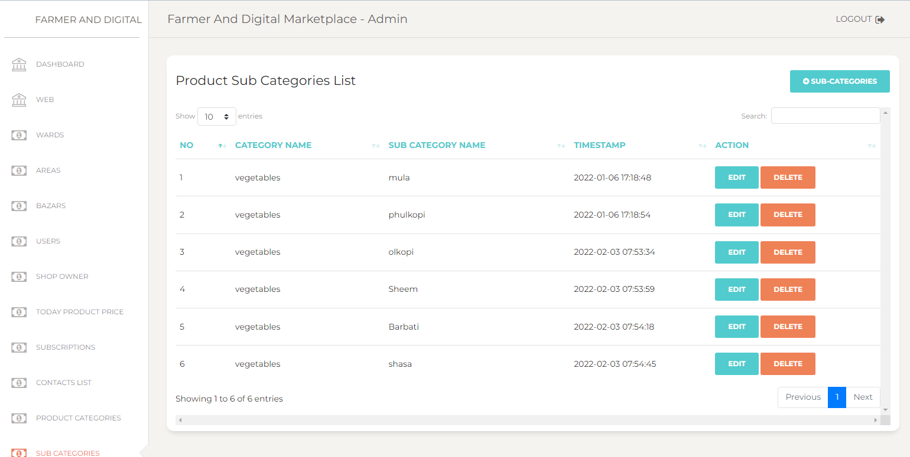
Implementation (admin)

Slide 16
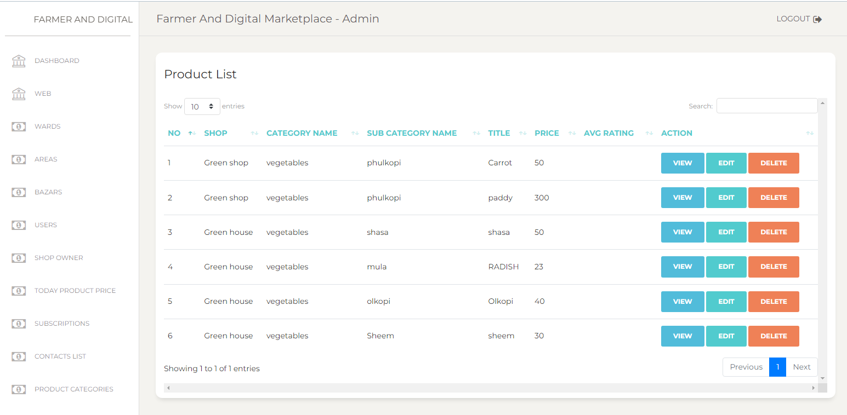
Implementation (admin)

Slide 17
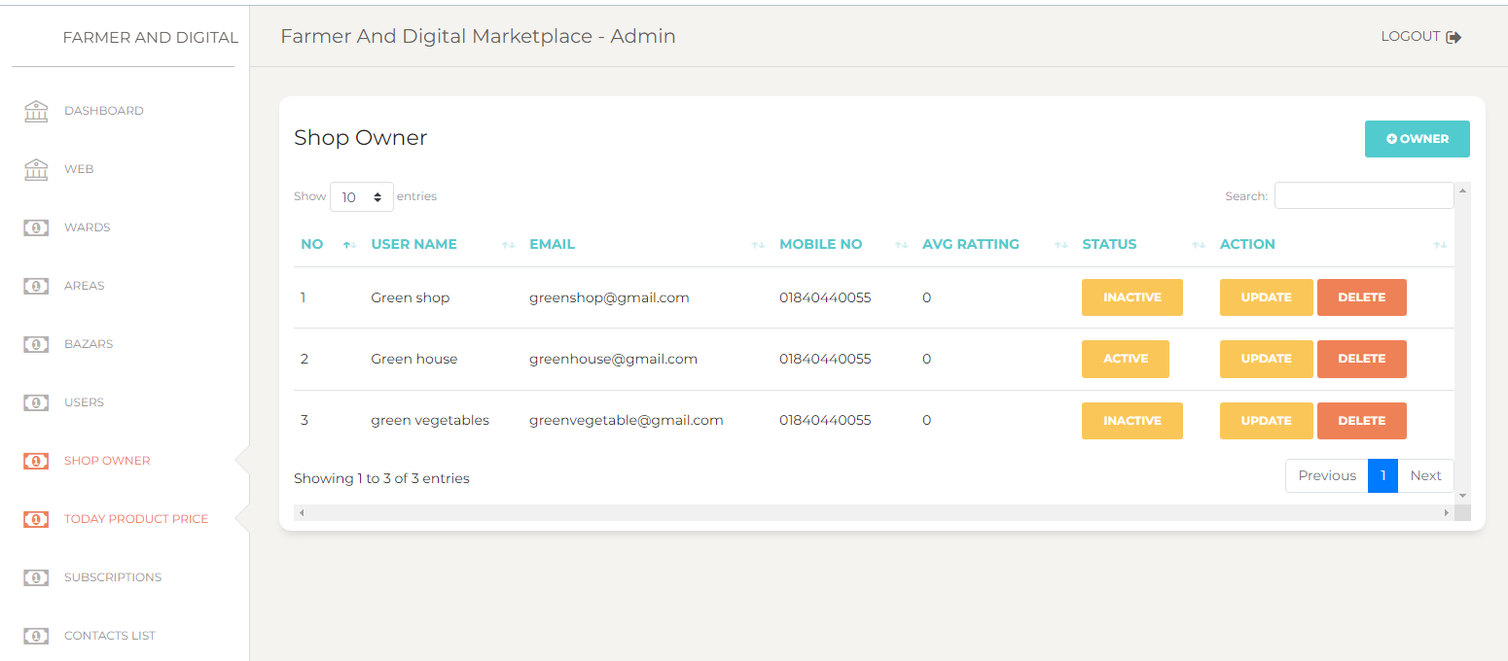
Implementation (admin)

Slide 18
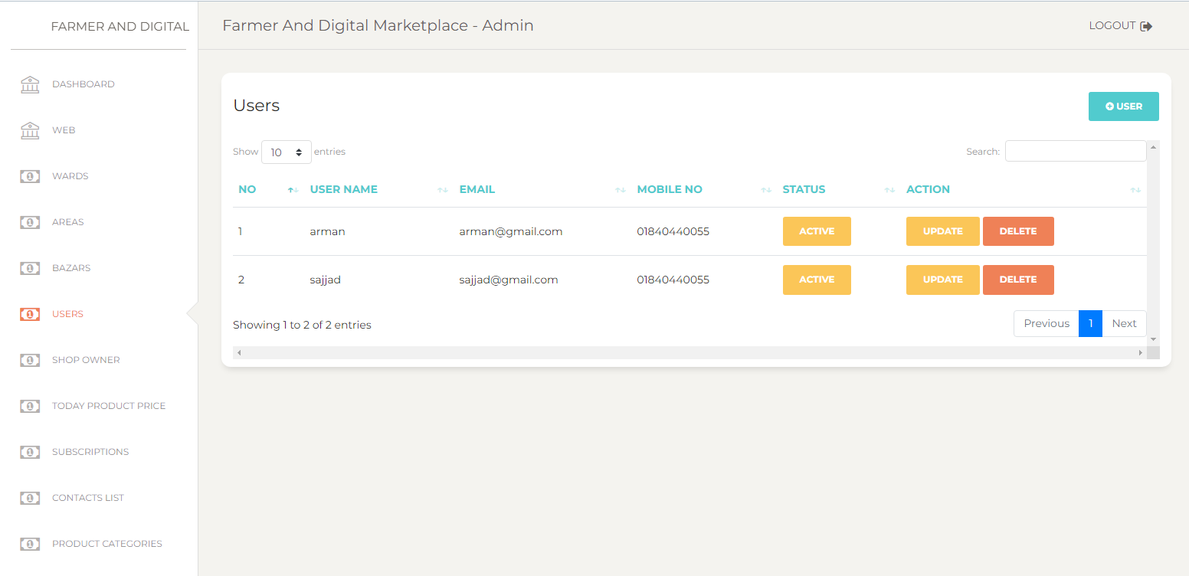
Implementation (admin)

Slide 19
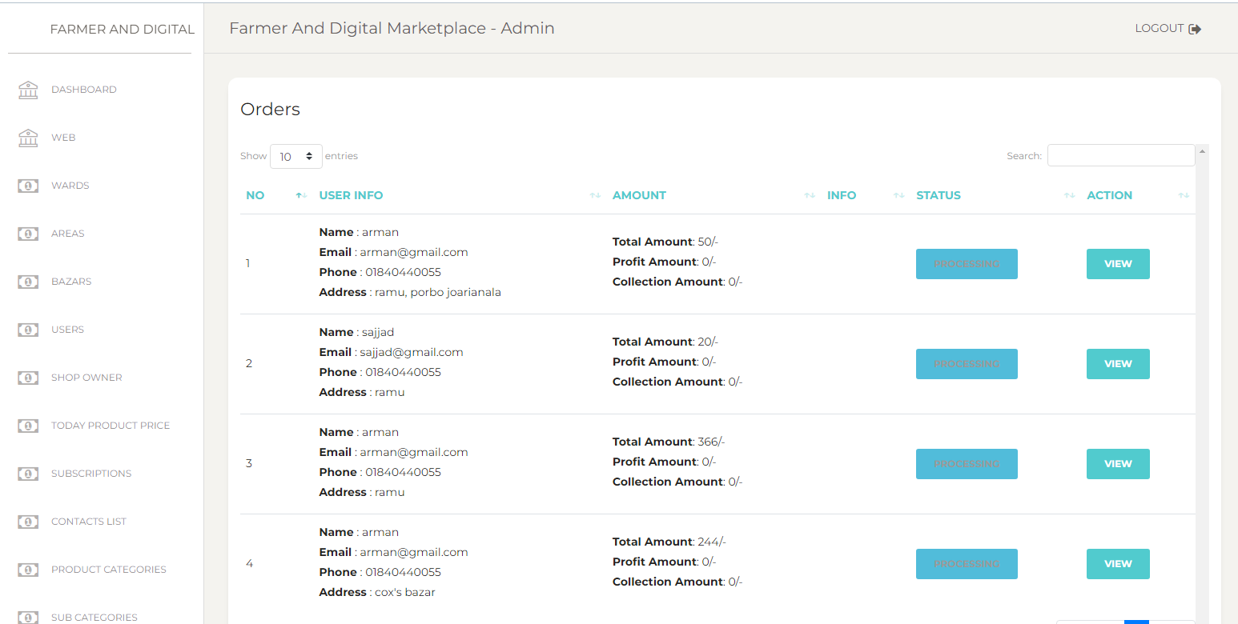
Implementation (admin)

Slide 20
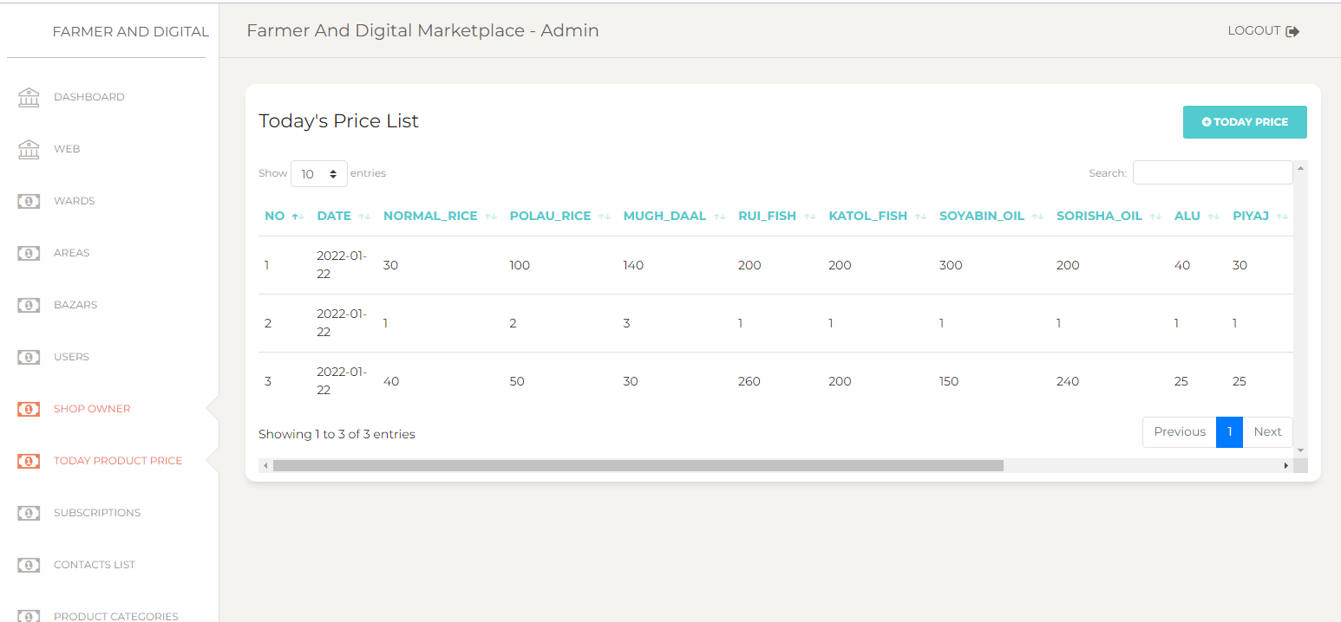
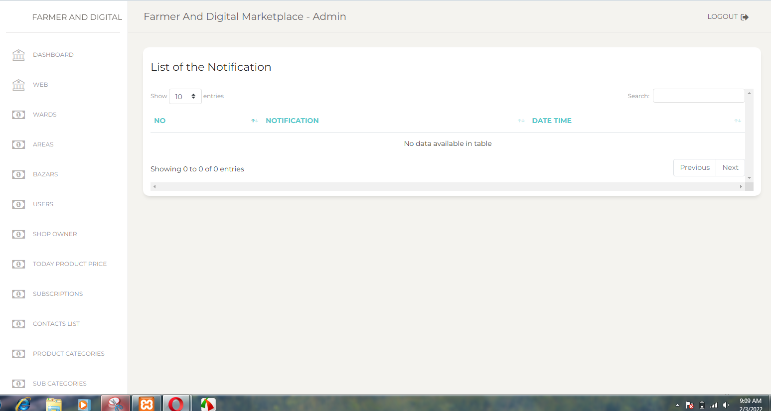
Implementation (admin)

Slide 21
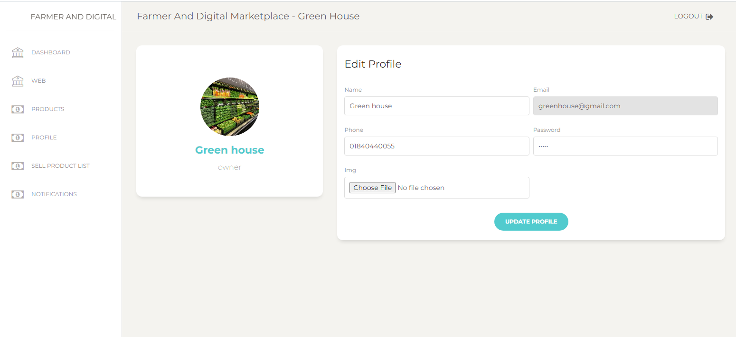
Implementation (shop owner)

Slide 22
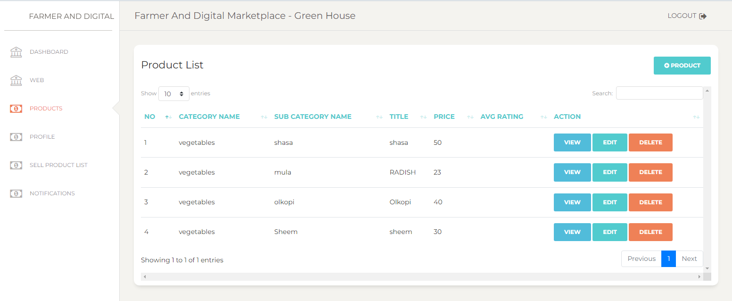
Implementation (shop owner)

Slide 23
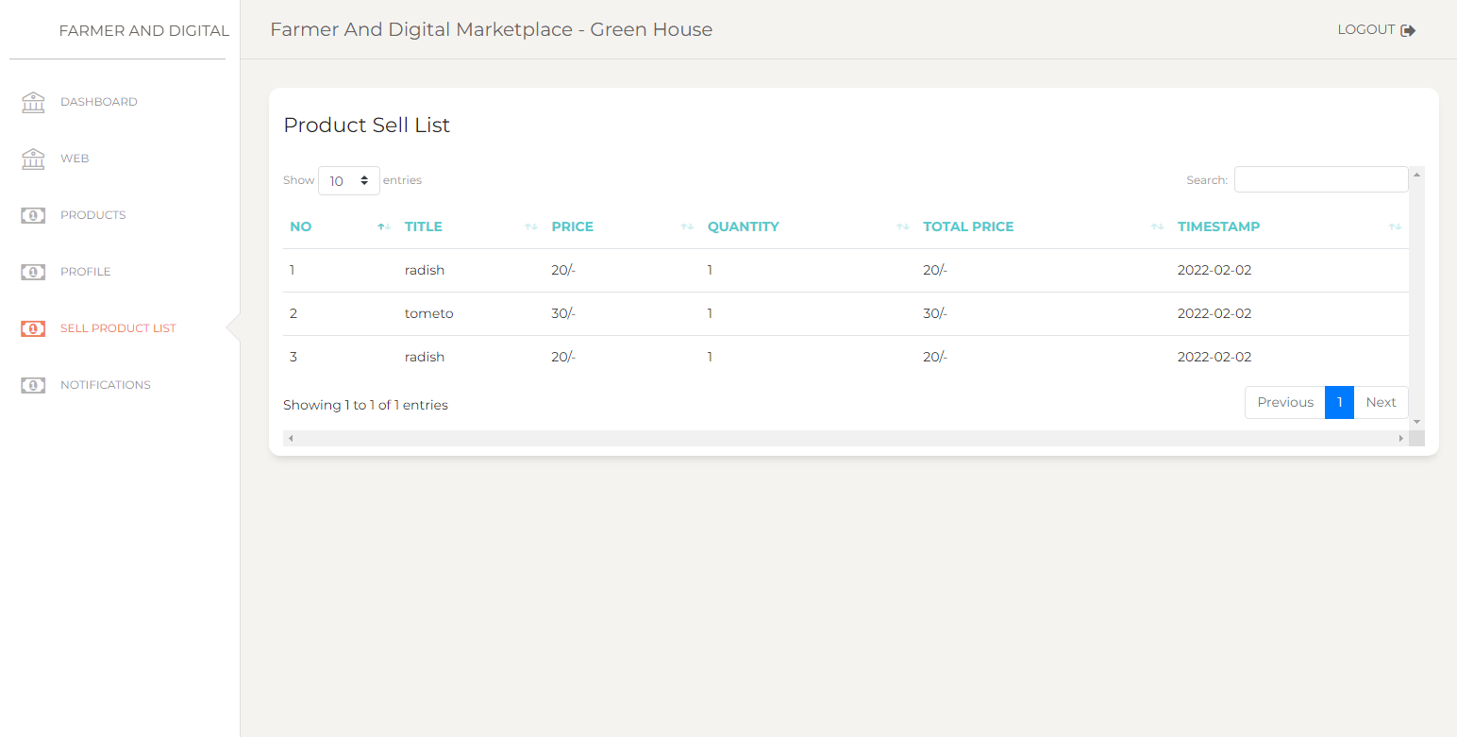
Implementation (shop owner)

Slide 24
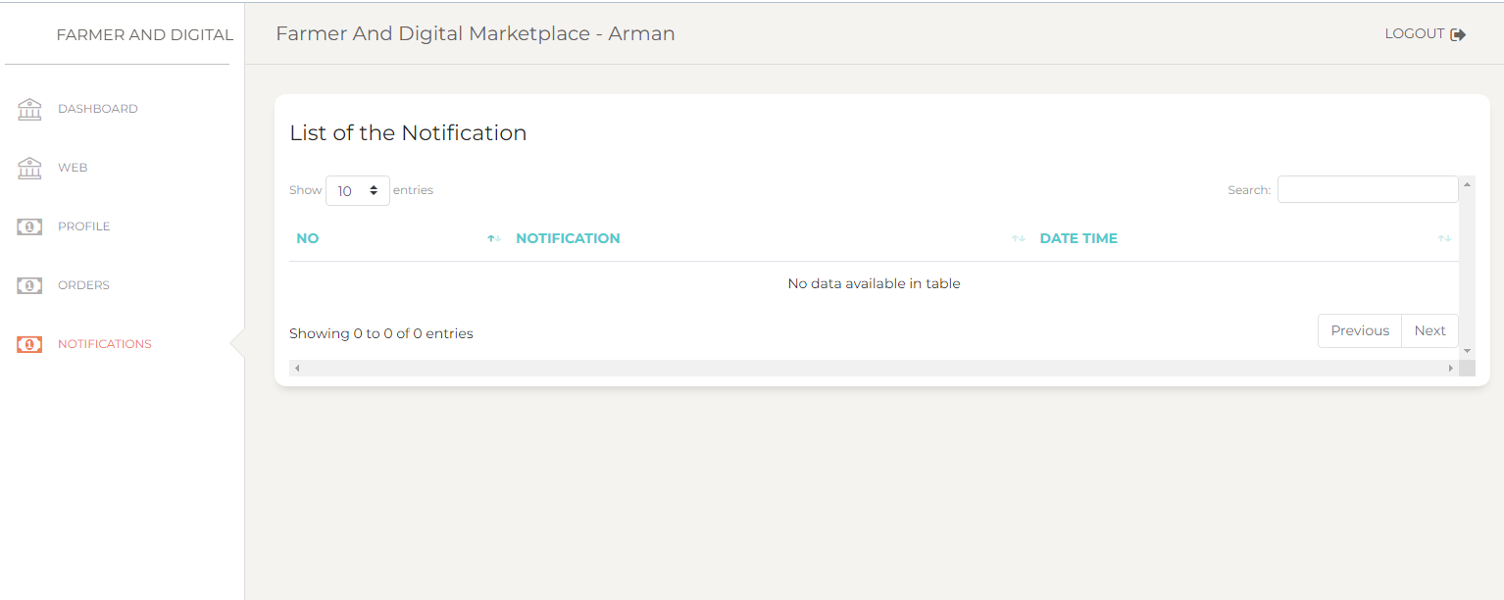
Implementation (shop owner)

Slide 25
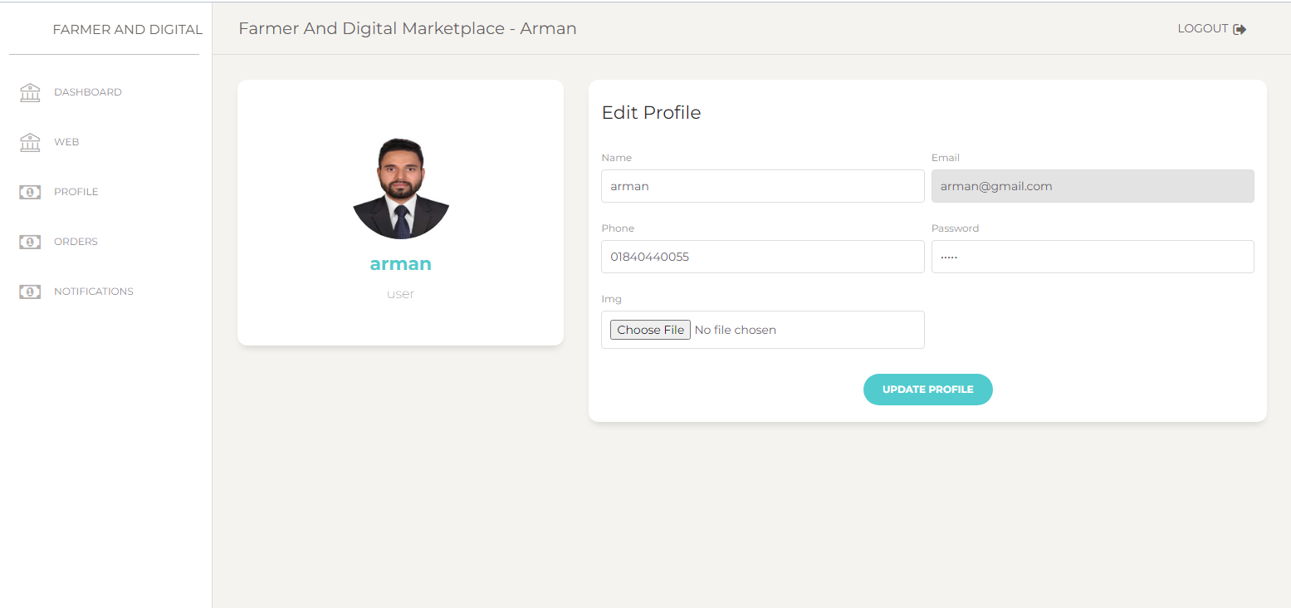
Implementation (user)

Slide 26
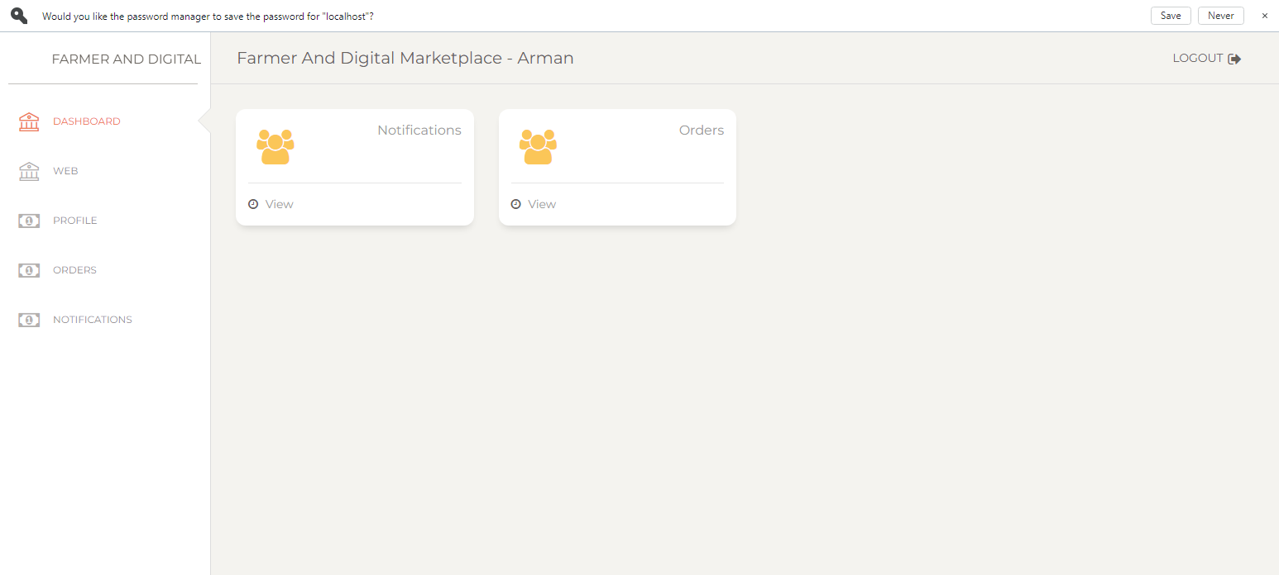
Implementation (user)

Slide 27
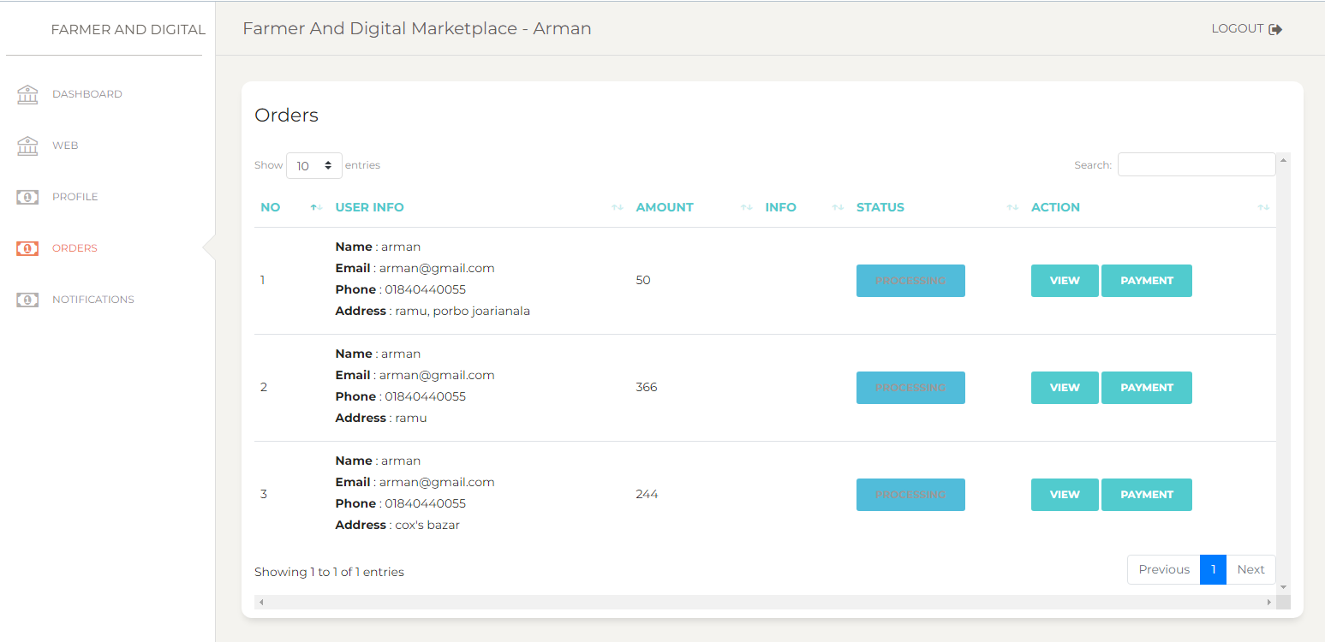
Implementation (user)

Slide 28
Implementation (user)

Slide 29
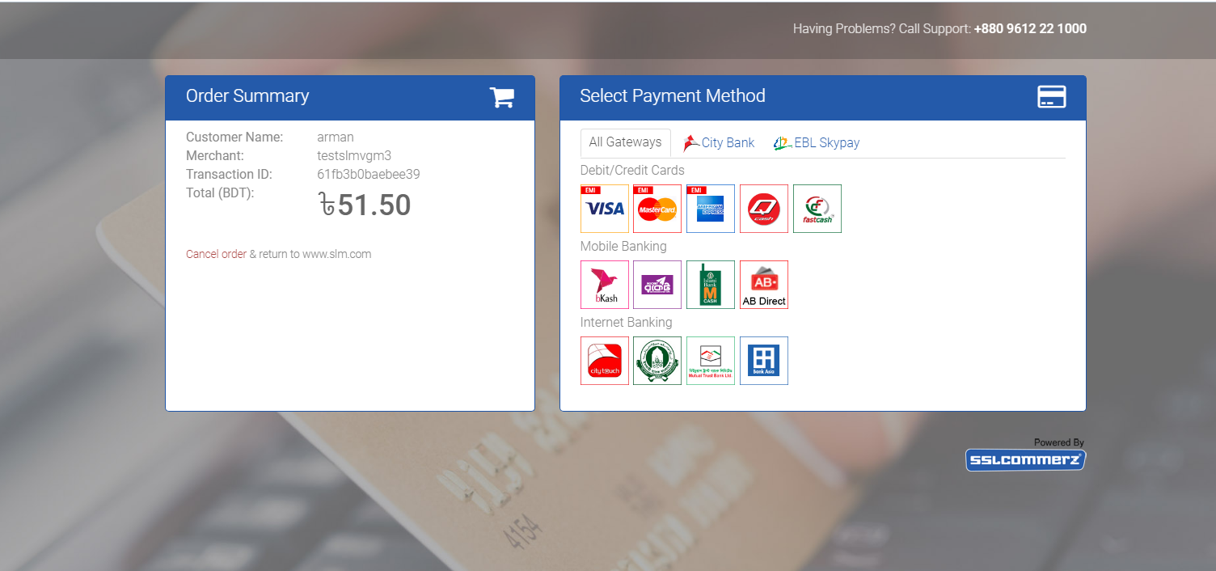
Implementation (user payment)

Slide 30
Conclusion
The system will be much user friendly so that the farmers can use the system easily. By this project farmers will get benefited they will get actual price of the product and the customers will also get benefited because they can buy products at a cheaper rate and fresh products

Slide 31
Thank you

